Slide 1
Ch.9 Terahertz Optics
Lee Jong Geon

Slide 2
Contents
Terahertz Optical Materials
Metal Reflectivities
Gaussian Optics
Dichroic Optical Elements
Wire-Grid Polarizers
Antireflection Coatings
Photonic Crystal Fibers and Terahertz Waveguides

Slide 3
Terahertz Optical Materials

Slide 4
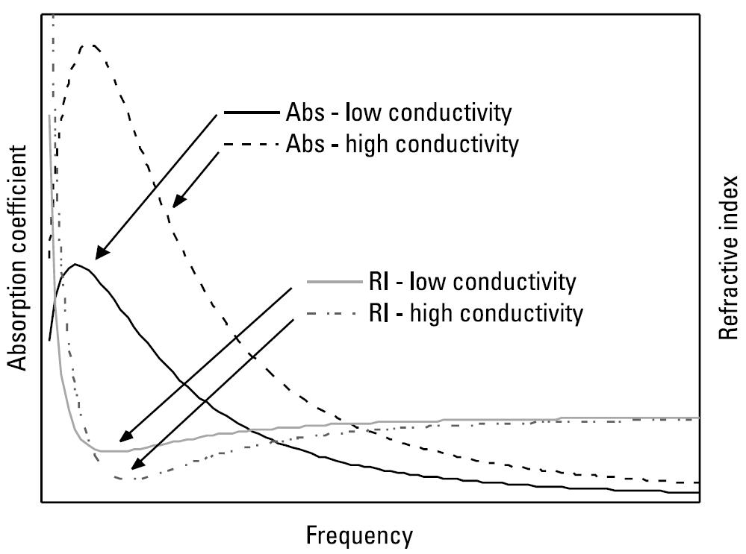
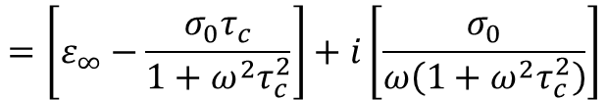

1.1 Transparency at Terahertz Frequencies
Material absorption at terahertz frequencies arises from several mechanisms
Free Carrier Absorption
Frequency-dependent absorption by free carriers may be generally described by the Drude model of carrier transport
$$ε=ε^{′}+ε^{′′}=ε_{∞}+i\frac{σ\left(ω\right)}{ω}=ε_{∞}+\frac{iσ_{0}}{ω\left(1−iωτ_{c}\right)}$$
$$=\left[ε_{∞}−\frac{σ_{0}τ_{c}}{1+ω^{2}τ_{c}^{2}}\right]+i\left[\frac{σ_{0}}{ω\left(1+ω^{2}τ_{c}^{2}\right)}\right]$$
0.1~0.5 THz

Slide 5
1.1 Transparency at Terahertz Frequencies
Absorption by Lattice Modes (Phonons)
Resonant absorption of radiation occurs when the frequency of the incident terahertz wave matches that of vibrational modes (phonos) of the lattice.

Slide 6
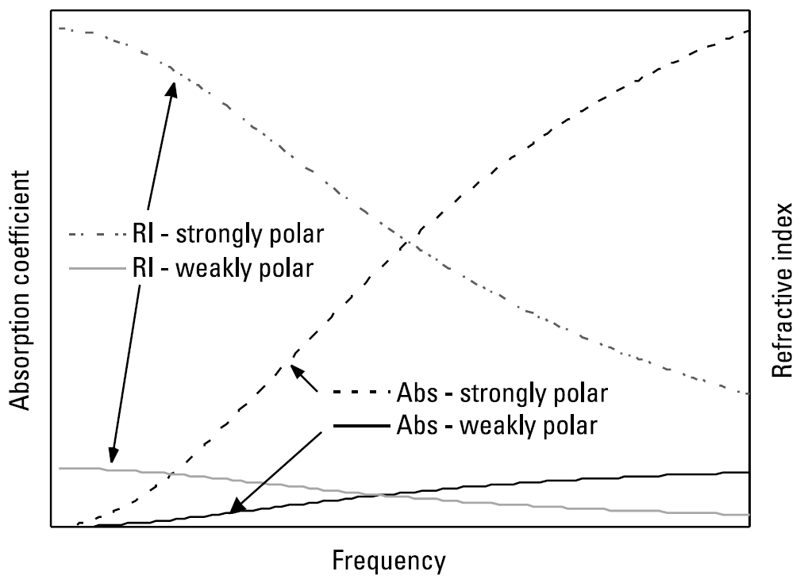
1.1 Transparency at Terahertz Frequencies
Dielectric Reaxations in Polar Materials
At higher frequencies the diploe motions are impeded by friction in the material, in consequence of which their response is delayed relative to the field, manifesting as absorption.

Slide 7
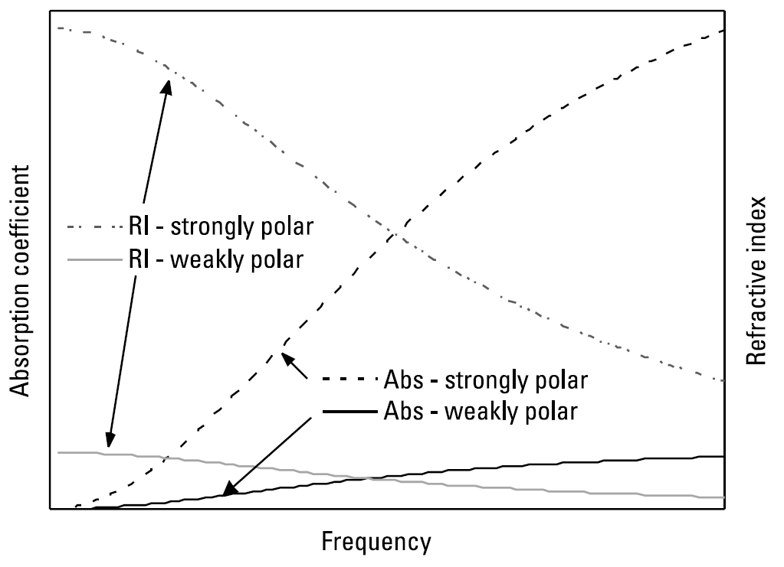
1.1 Transparency at Terahertz Frequencies
Disorder-Induced Absorption in Amorphous Materilas
Medium- and long-range microscopic disorder in amorphous materials gives rise to absorption by coupling terahertz radiation into the acoustic phonon modes.

Slide 8
1.2 Inorganic Crystals for Terahertz Optics
Silicon
High resistivity float-zone silicon is the premier optical material for terahertz frequencies owing to its very low absorption and negligible dispersion from below 0.1 to ~13 THz
Resistivity: ~ 10kΩ cm ➔ high terahertz transparency
Good mechanical strength
Phonon resonance high frequency (18.4 THz)
Refractive index: 3.42
Germanium
Similar to silicon in many respects
Resistivity: ~ 50Ω cm ➔ limited at low frequencies by Drude absorption
Range: 1 ~ 8 THz, phonon resonance 9 THz
Refractive index: ~4

Slide 9
1.2 Inorganic Crystals for Terahertz Optics
Quartz (SiO₂)
High
Sapphire (Al₂O₃)
Similar

Slide 10
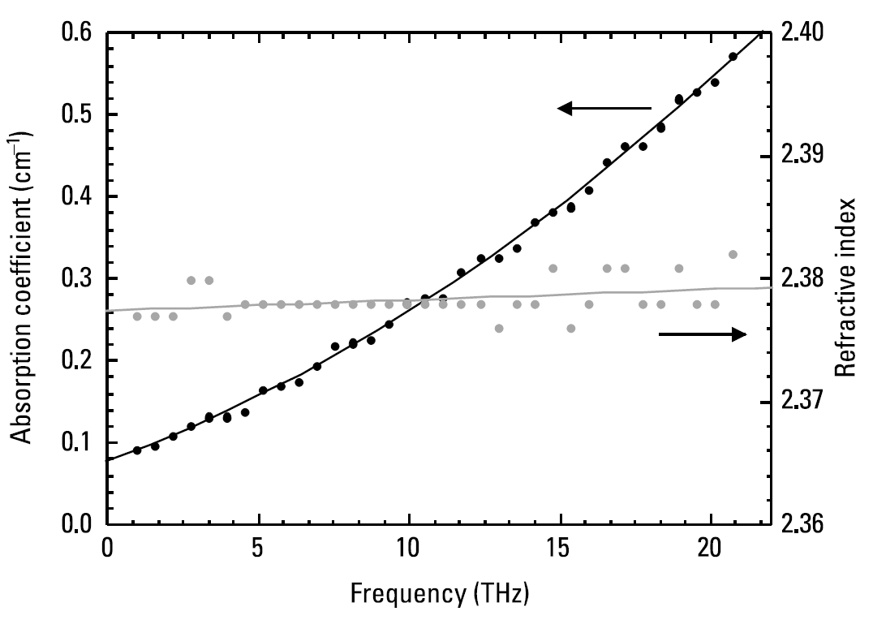
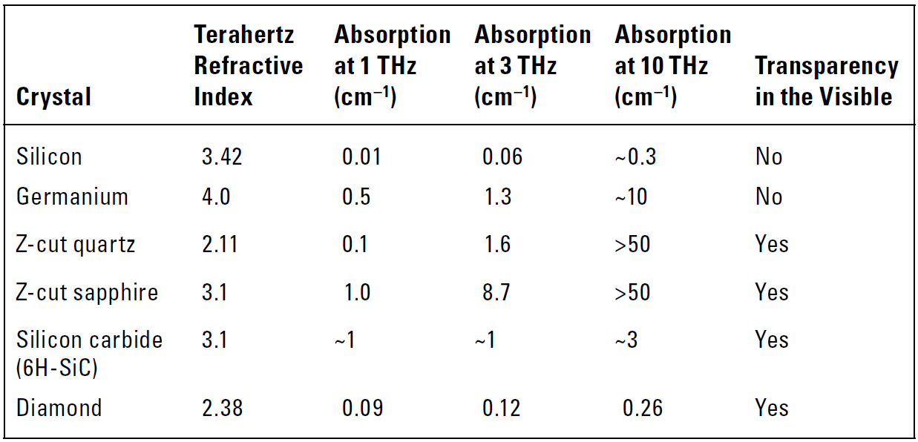
1.2 Inorganic Crystals for Terahertz Optics
Diamond
Diamond is an excellent terahertz optical material, however its use limited by its high cost and the difficulty of fabricating shapes other than thin wafers
phonon absorption: 60THz
Silicon Carbide (SiC)
SiC appears to be highly promising as a material for terahertz optics
Reststrahlen band: 20 ~ 30 THz
Refractive index: ~ 3.1

Slide 11
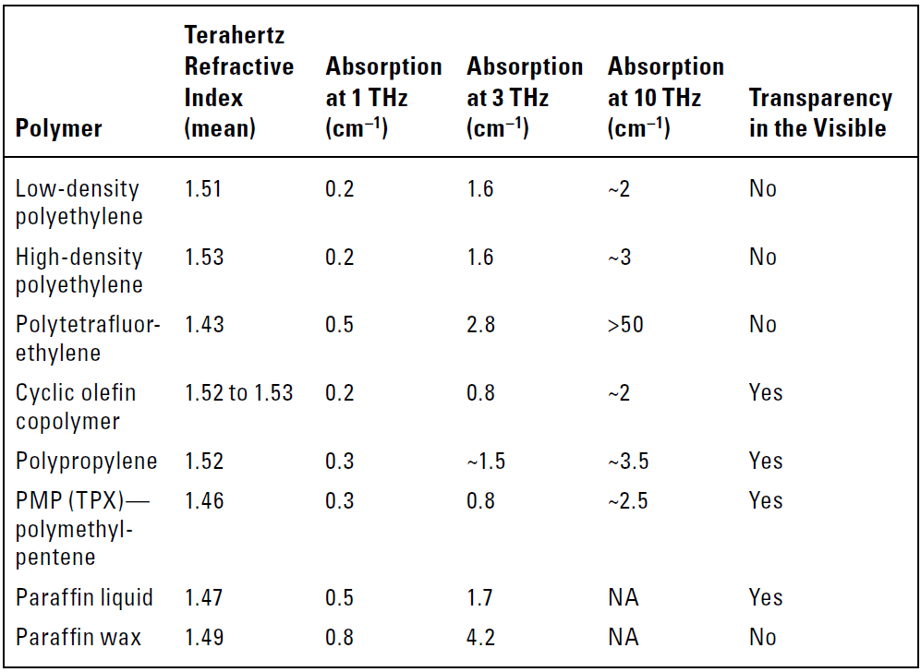
1.3 Polymers for Terahertz Optics

Slide 12
Metal Reflectivities

Slide 13
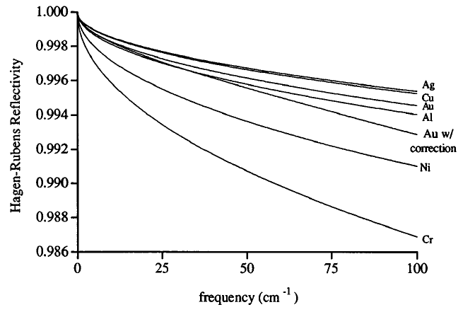
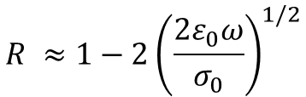
2. Metal Reflectivities
Metallic mirrors are arguably the most crucial components of any terahertz system.
The power reflectivity of a good conductor:
$$R ≈1−2{\left(\frac{2ε_{0}ω}{σ_{0}}\right)}^{1/2}$$
➔ Reflectivity $∝$ Conductivity
Gatesman, A. J., R. H. Giles, and J. Waldman, “High-Precision Reflectrometer for Submillimeter Wavelength,” J. Opt. Soc. Am. B, Vol. 12, 1995.

Slide 14
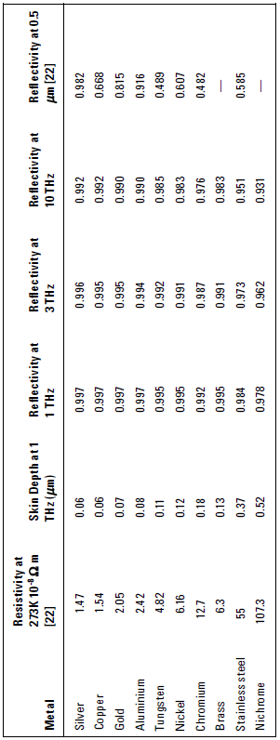

2. Metal Reflectivities
The thickness of the metal coating on a mirror must be sufficiently large
➔ It must be capable of containing the currents induced by the interaction with the electromagnetic field.
$$δ=\sqrt{\frac{2}{ωμ_{0}σ_{0}}}$$

Slide 15
Gaussian Optics

Slide 16
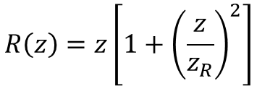
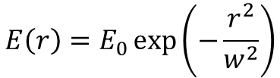
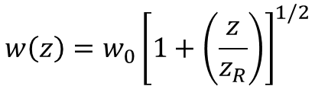

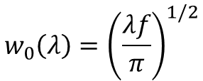
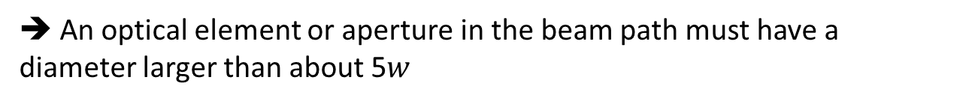
3.1 Gaussian Beams
Radiation in the terahertz band has wavelength that are comparable to the sixe of the optical ccomponents.
The Gaussian bean radial distribution
$$E\left(r\right)=E_{0}\exp\left(−\frac{r^{2}}{w^{2}}\right)$$
➔ An optical element or aperture in the beam path must have a diameter larger than about 5$w$
The minimum radius of the beam waist
$$w_{0}\left(λ\right)={\left(\frac{λf}{π}\right)}^{1/2}$$
Rayleigh length
$$z_{R}\left(λ\right)=\frac{πw_{0}^{2}}{λ}$$
Beam waist & wavefront radius
$$w\left(z\right)=w_{0}{\left[1+\left(\frac{z}{z_{R}}\right)\right]}^{1/2}$$
$$R\left(z\right)=z\left[1+{\left(\frac{z}{z_{R}}\right)}^{2}\right]$$

Slide 17
Dichroic Optical Element

Slide 18
4.1 Terahertz Transparent/Visible Opaque
It is often necessary to combine visible and terahertz beams so that they copropagate, or to remove or redirect one of the beams
Expanded polymer foams
In many ways, polymer foams fulfill best the required criteria
➔ Low frequency-independent terahertz loss, low refractive index, low beam distortion, high loss in the visible, low cost
Nonpolar polyemrs (HDPE, PTFE)
( + ): Higher mechanical strength, can be formed in to lenses
( - ): Higher transmission loss than foams
High-resistivity silicon
( + ): The lowest terahertz absorption over the greastest bandwidth
( - ): Sufficiently high optical intensities the concentration of generated photocarriers can produce significant terahertz absorption.

Slide 19
4.2 Terahertz Opaque/Visible Transparent
Optical glasses have strong terahertz absorption.
➔ BK7, pure SiO₂
Glass has several important advantages for this role
➔highly transparent, distortion-free optical windows, antireflection coating does not affect its performance
Other materials: Perspex (polymethylmethacrylate), polystyrene, polar crystals (LiNbO₃, TiO₂)

Slide 20
4.3 Terahertz Reflective/Visible Transparent
Visible transparent conductive coatings can act as reflective surfaces for terahertz radiation.

Slide 21
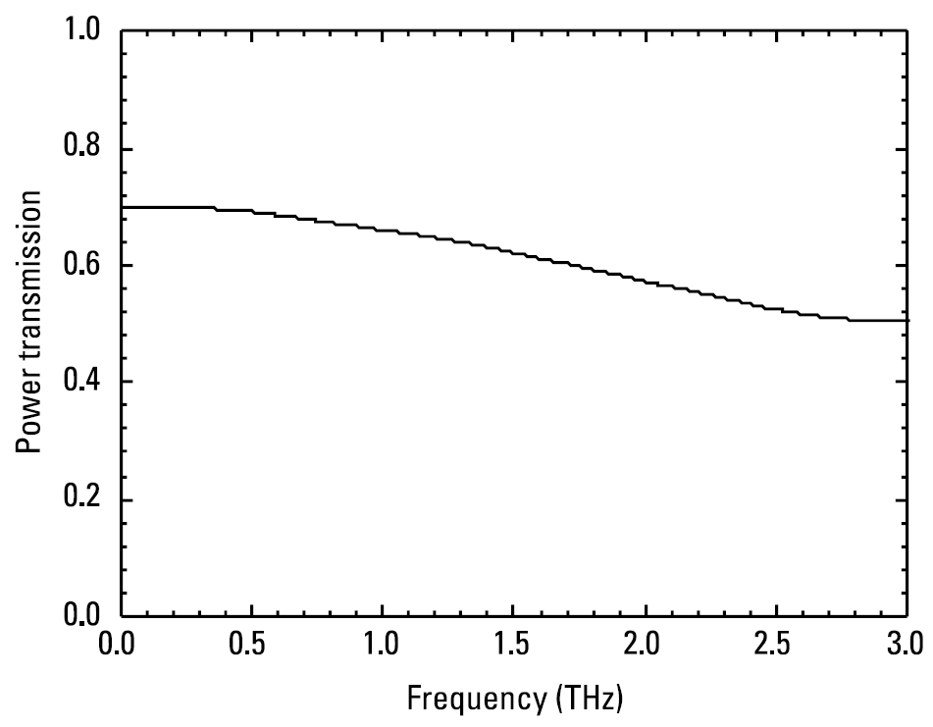
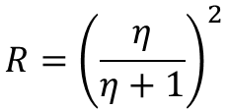

4.4 Terahertz Transparent/Visible Reflective
Such films are semitransparent to terahertz beams and are semireflective in the visible
Visible freq. skin depth <Film thickness< Terahertz freq. skin depth
$$R={\left(\frac{η}{η+1}\right)}^{2}$$
$$η=\frac{nk}{2}\frac{d}{δ}$$
TPX (Polymethylpentene)
- Reflectivity of approximately 80% in the visible

Slide 22
Wire-Grid Polarizers

Slide 23
5. Wire-Grid Polarizers
The thickness of the metal coating on a mirror must be sufficiently large
➔ It must be capable of containing the currents induced by the interaction with the electromagnetic field.

Slide 24
Antireflection Coatings

Slide 25
6. Antireflection Coatings
The thickness of the metal coating on a mirror must be sufficiently large
➔ It must be capable of containing the currents induced by the interaction with the electromagnetic field.

Slide 26
Photonic Crystal Fibers and
Terahertz Waveguides

Slide 27
7. Photonic Crystal Fibers and Terahertz Waveguides
The thickness of

Slide 28
References
Gatesman, A. J., R. H. Giles, and J. Waldman, “High-Precision Reflectrometer for Submillimeter Wavelength,” J. Opt. Soc. Am. B, Vol. 12, 1995, pp. 212-219.

